Slide 1
INTEGRATION TESTING PLATFORM
VirtuProbe Studio
End-to-end integration testing across every protocol your services speak, from one workbench.
Product overview
virtuprobe.studio
Notes:
Opening slide. VirtuProbe Studio is a workbench for testing the way systems talk to each other, across every protocol those systems use. The line to land in person: a service is only correct when it talks to the registers, the identity directory, the mail gateway and the databases around it. That is exactly the part that is hard to test today.

Slide 2
THE PROBLEM
A service is only correct when it talks to the others
Services reach each other over many protocols at once. A registration goes out over HTTP, a confirmation arrives over email, an identity check runs against a directory and a record has to land in a database. Each part can pass on its own while the path between them is broken.
The usual way to check that path is a set of one-off scripts and manual steps, different for every protocol, hard to repeat for the next release and harder to hand to someone else.
Notes:
Set up the pain before the product. The failure teams know well: every component is green in isolation and the path through them still fails. The second paragraph names the status quo without naming any tool. Do not oversell it. The integration path is the untested part.

Slide 3
WHAT IT IS
One workbench, sixteen protocols
Each protocol is a probe you compose in a visual editor, with no test code to write. The same editor builds a single-call check or a step in a longer chain.
HTTP
DNS
SMTP
IMAP
LDAP
Kerberos
SMB
SpamAssassin
MySQL
PostgreSQL
SQL Server
MongoDB
Redis
FTP
STOMP
Freestyle
Notes:
The grid is the proof of breadth. It covers web, email, directories, the Windows and Active Directory services, the main databases and a raw byte-level protocol (Freestyle) for anything bespoke. The message: whatever a system speaks, there is a probe for it, in one workbench rather than one per protocol.

Slide 4
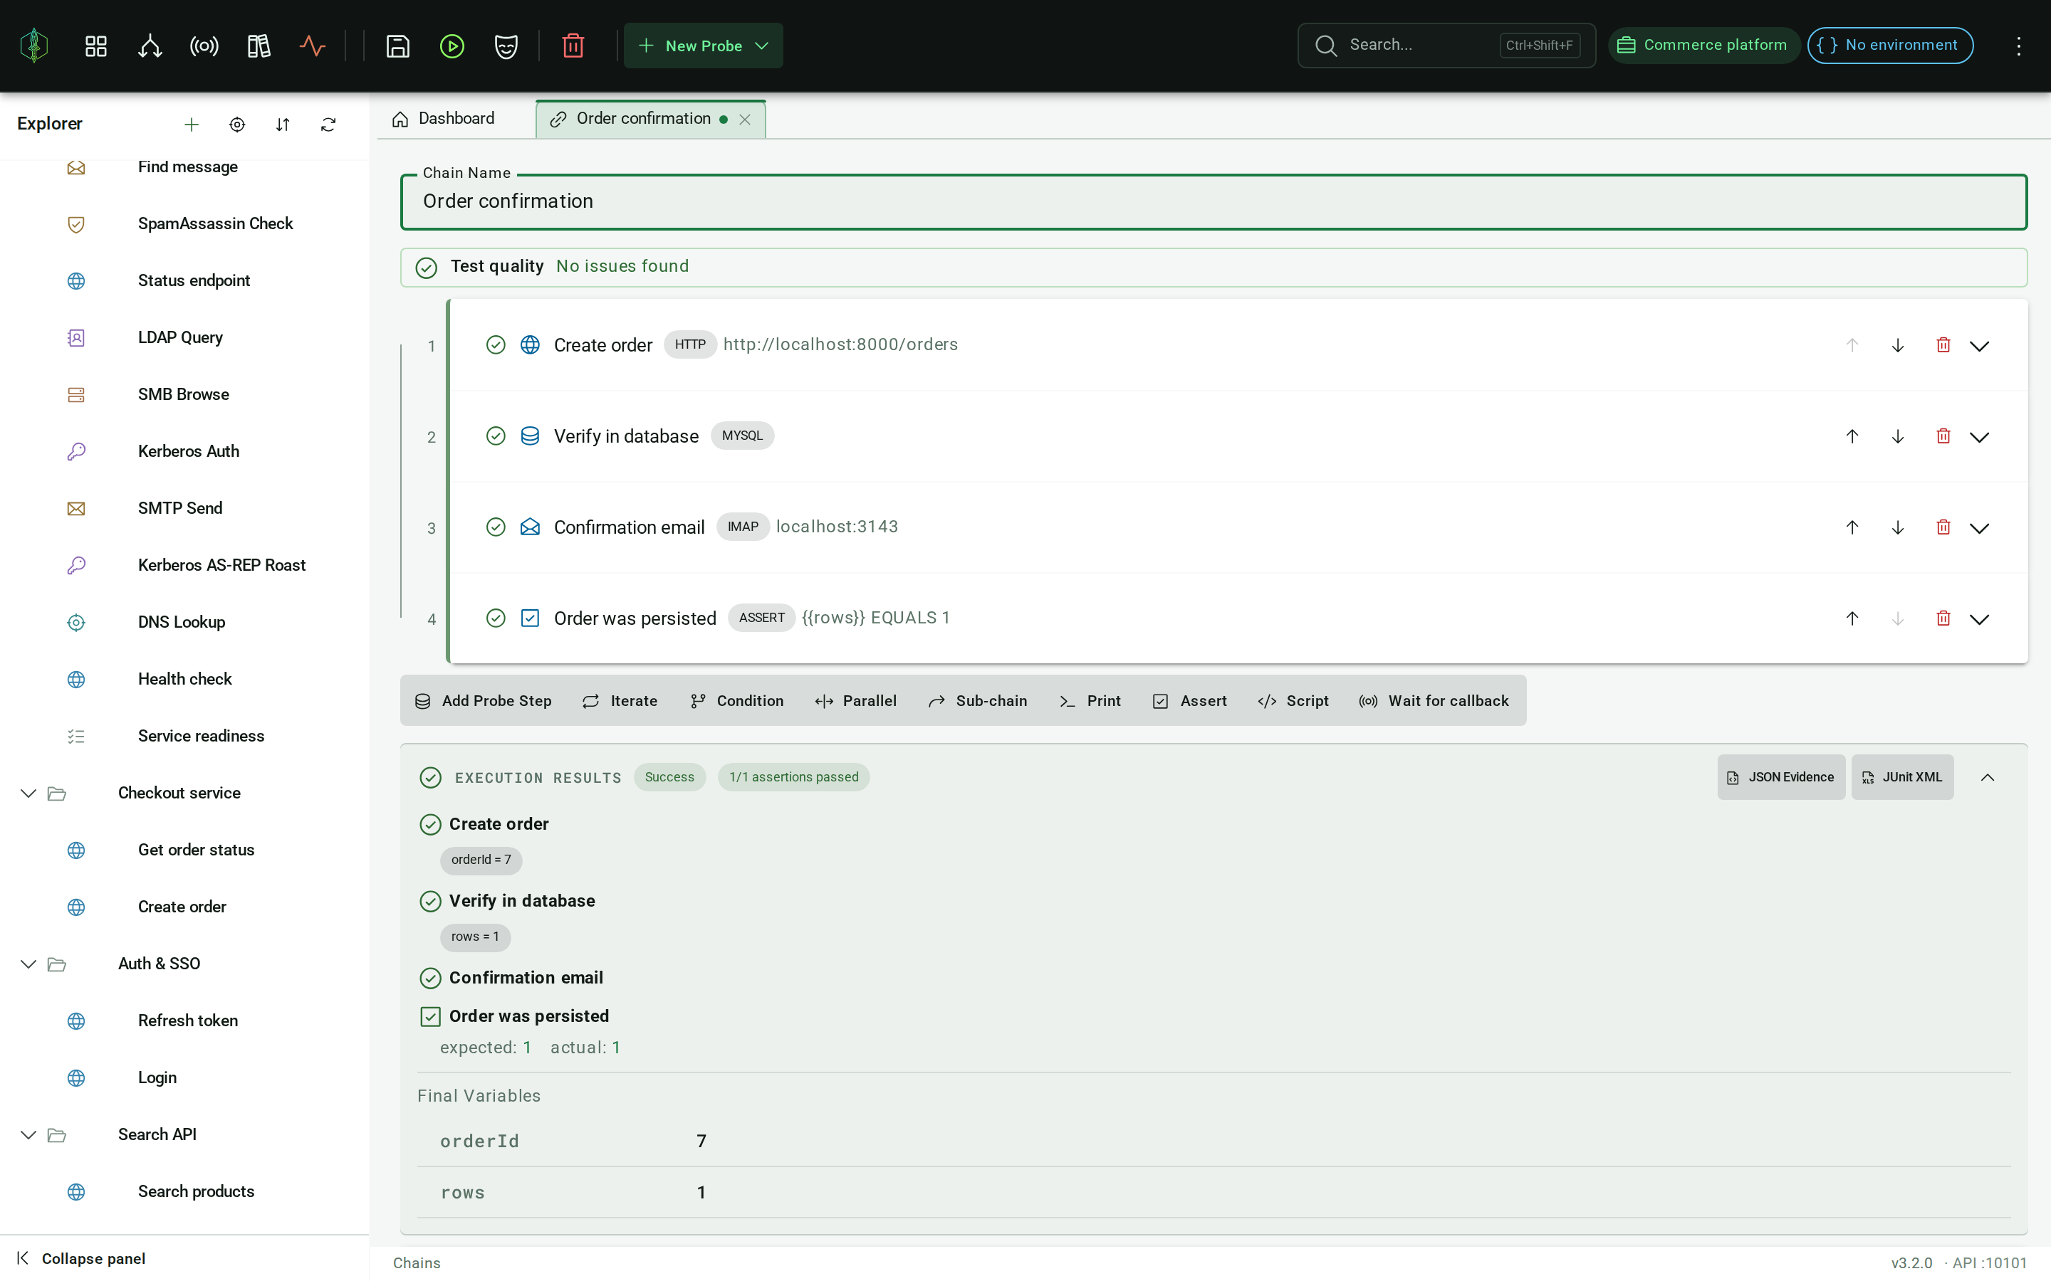
INTEGRATION
A chain that follows the whole path
Steps pass data to each other through {{variables}}. You build the full path across protocols as one chain, iterate over a list, branch on a response, fan steps out in parallel or call another chain as a sub-routine.
Every run comes back with a JUnit report, the pass or fail on each step and the raw responses still there to read.
One chain across HTTP, a database and email, each step feeding the next.
Notes:
The core differentiator. A signup goes out over HTTP, the confirmation arrives over IMAP, the link is followed and the account is checked in the database, as one test. The screenshot shows a real chain running. Mention that the raw responses are kept, which matters for an audit trail.

Slide 5
INTEGRATION
Build once, run in three places
Workspaces are git-backed, so a test is a file your team reviews like any other change. The same chain runs in three places with no rewrite.
Desktop
Everything runs on the machine the application is installed on, with nothing to stand up first.
CI pipeline
The same chains and suites run without a screen, returning a JUnit report the build can gate on.
Execution server
A container deployed where the targets live, so probes fire from inside the network.
Notes:
This slide answers the practical question a CI or ops team asks straight away: where does it run. The git-backed point is worth dwelling on, because it means tests are reviewed and version-controlled like code. The execution server card sets up the next section on running inside a closed network.

Slide 6
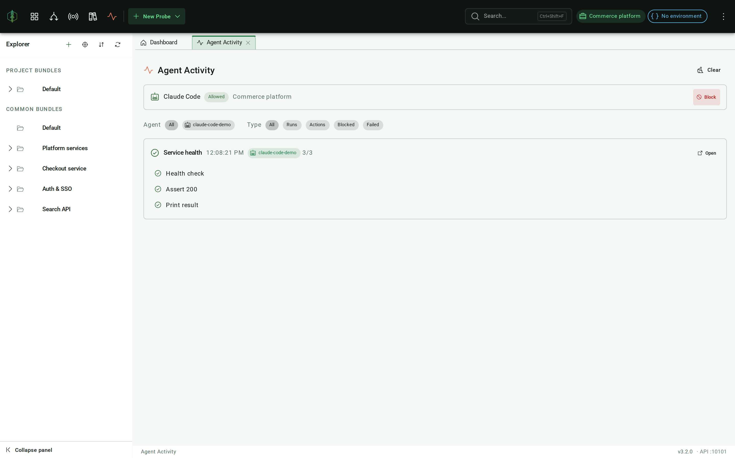
AGENTIC TESTING
An agent can build and run the tests
VirtuProbe runs an MCP server, so a coding agent can author probes, chains and suites in your workspace, run them and read back the evidence. It makes an ordinary chain in an ordinary bundle, which you can open, change and rerun.
The agent works under the license you already have, with a fixed set of 26 tools. It is never handed a secret. It names a stored credential; it never sees its value.
Agent Activity: every run an agent starts, listed step by step.
Notes:
The modern angle. Your teams may already have coding agents in play. The worry is always what an agent can touch and what it can see. Two facts carry the slide: the agent works under the existing license with a fixed tool set, so there is nothing new to procure or lock down. It is never given a secret value, only the name of a credential the workspace holds. The next slide is the control story.

Slide 7
AGENTIC TESTING
You decide what an agent can reach
01
Read on connect
A new agent can read the workspace, but it can change or run nothing until you approve it.
02
Approve by project
Approving is a choice of which projects the agent may touch. Every write or run is refused outside that grant.
03
Revoke anytime
You can block an agent while it is working. Agent Activity lists every run it starts, step by step.
Notes:
For a security-minded buyer, the grant model carries the slide. The grant is an explicit per-project decision, enforced on every write and run. It is reversible mid-flight. Agent Activity gives the human a live view of what the agent did. Frame it as least privilege with a full audit view.

Slide 8
DATA SOVEREIGNTY
Your data never leaves your environment
VirtuProbe Studio is a desktop application. By default everything it needs runs on the machine it is installed on. There is no VirtuProbe cloud service that handles your requests.
Your probes, your workspaces and the responses you record stay with you. Data travels only to the targets you point a probe at yourself.
Notes:
This is the slide that matters most for a security-minded buyer. Say it plainly and let it sit. There is no hosted service in between, so adopting the product does not mean sending anything to a vendor. The only outbound traffic is the probe hitting the target the team chose. Pause here for questions about where data lives.

Slide 9
DEPLOYMENT
When your targets are out of reach
For systems your own machine cannot reach, the part that sends the traffic runs apart from the application. The execution server ships as a container image deployed inside the environment under test. The application connects to it, so probes fire from inside the network rather than across a VPN.
VirtuProbe Studio
your desktop
Execution server
container, inside your network
Target systems
registers, directories, databases
For a closed network, the license travels as a signed file, so activation needs no outbound connection.
Notes:
The architecture slide for the ops and security people. The flow reads left to right: the application stays on the desktop, the execution server goes into the network under test as a container. The probes reach the targets from inside. Close on the air-gapped license line, because a fully disconnected environment is a common case and the usual blocker for a hosted tool.

Slide 10
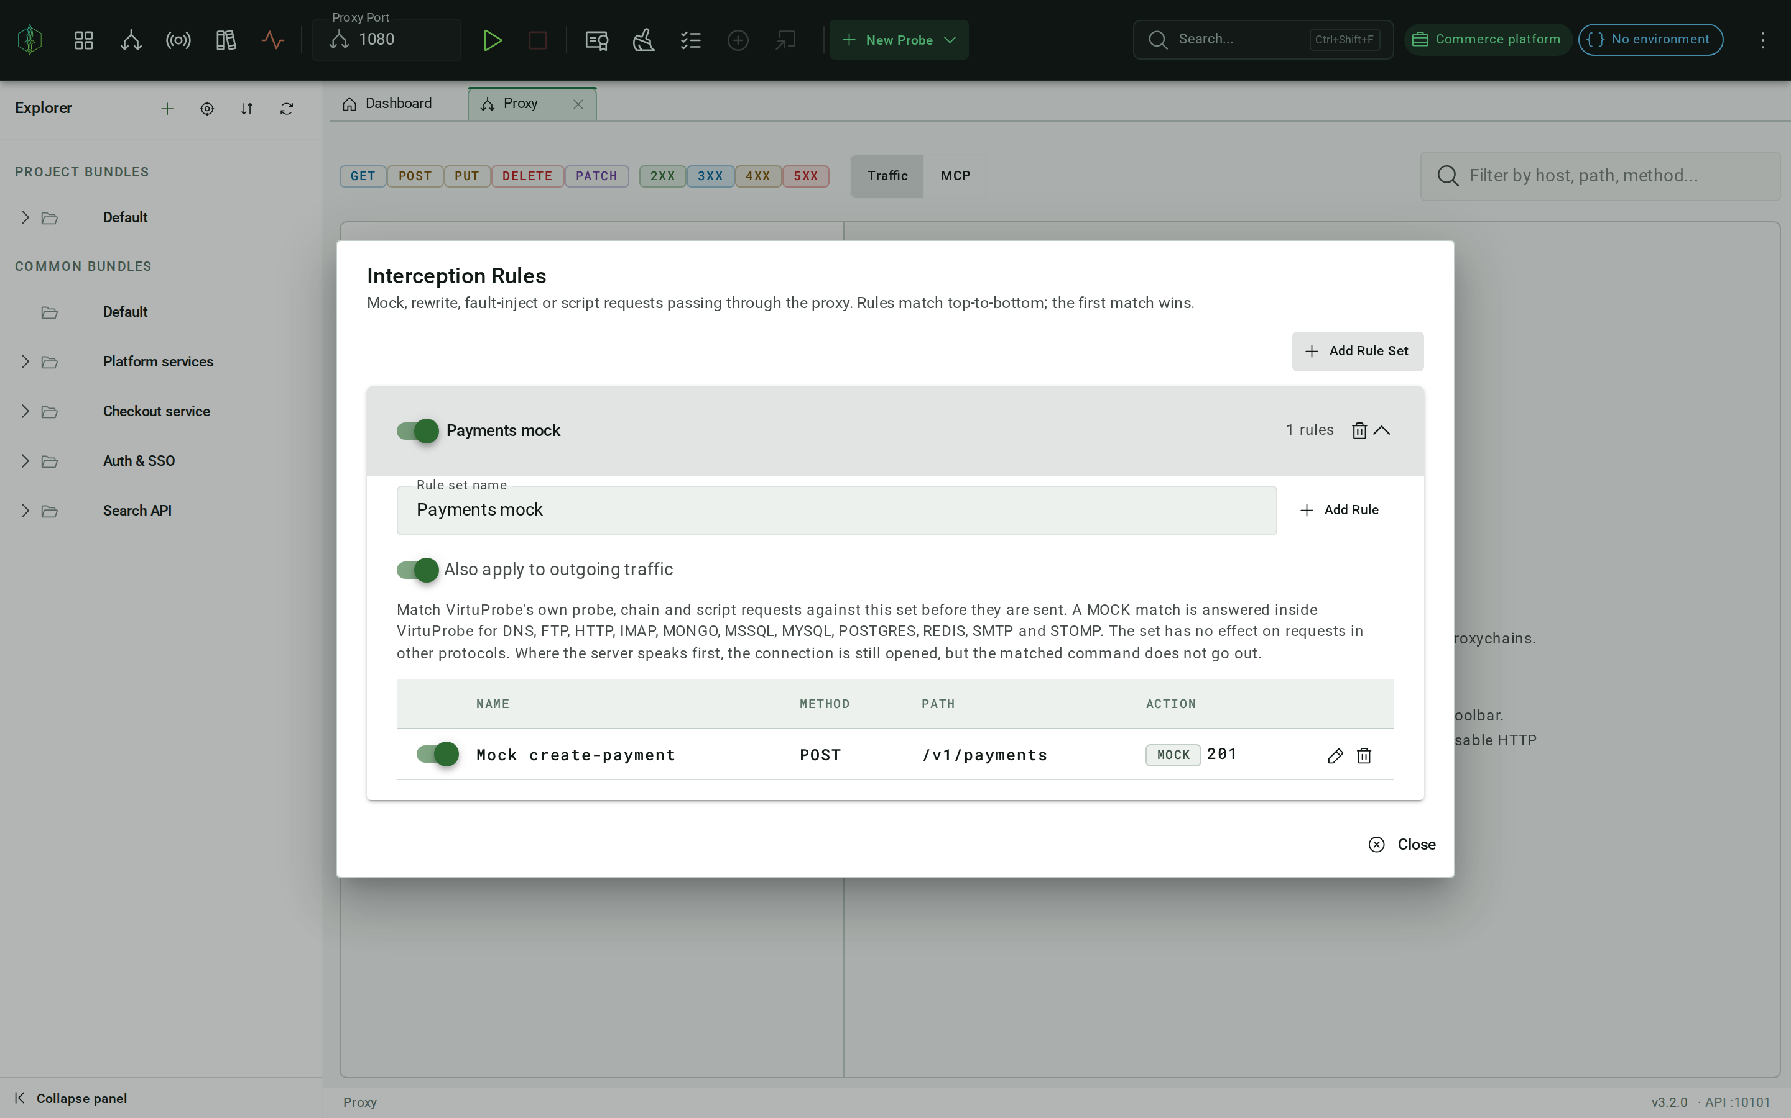
WHEN YOU NEED IT
Protocol-level and security testing
Every protocol is written against its specification rather than wrapped from a library, so the same workbench goes past confirming a call works to checking how a service behaves under conditions a normal client never produces.
Fuzzing
Send malformed input at a service and watch how it answers, one mutation at a time.
Interception
A proxy terminates TLS and lets you read and alter traffic as it passes, including an agent's MCP tool calls.
Interception: read and alter traffic as it passes, including an agent's MCP tool calls.
Windows and AD auth
Kerberos, SMB and LDAP, with NTLM, Pass-the-Hash and SPNEGO for enterprise directory testing.
Notes:
Deliberately framed as a capability rather than the lead, per the brief. The same workbench that runs integration tests can also push a service with malformed input, sit in the middle of a connection and exercise Windows and Active Directory authentication. Useful if your organization has a red team or a hardening program, without making the pitch about offensive security.

Slide 11
THE SHORT VERSION
Test the systems your services depend on, inside your own network, with evidence you keep.
Notes:
The accent slide and the one line to remember. Say it, let it breathe and move to the next step. It ties the three threads together: integration across many systems, running inside the network and a run that leaves a record you can hand to an auditor.

Slide 12
NEXT STEP
A pilot on your own systems
The fastest way to judge VirtuProbe is to point it at a few real integration paths and see the evidence come back. We can set up a short pilot inside your environment, with the execution server where your targets live.
1 Pick a handful of real integration paths.
2 Deploy the execution server inside your network.
3 Build the chains, run them and review the evidence together.
Jakub Stonavský · jakub@virtuprobe.studio · +420 603 544 437
virtuprobe.studio
Notes:
Close on a concrete, low-commitment offer: a short pilot inside their own environment, pointed at their own paths. The three steps keep it tangible. Fill the contact line with the right name, email and phone before sending. The product site is virtuprobe.studio.

